Slide 1


Code Visualization
Johan van den Muijsenberg
Notes:
I am Johan van den Muijsenberg. I have been working for Alten initially PTS for more than 20 years.
Have experiences in C++, C# and Java.
I setup and gave an internal course on OO software tens years ago. Also gave courses on UML tool Enterprise Architect for some years.
I am interested in software quality and code visualization. Have been using visualization tools for many years and even developed my own open source tooling.
You can find this presentation on github as part of my open source project.
As an experiment I used a more visual style in this presentation than I normally do inspired on the book ‘presentation zen’ by Garr Reynolds.
As a consequence there is no much text in the sheets, but you can find it back in the speaker notes.

Slide 2

Naming | Complexity
Cohesion | Coupling
ABC
Notes:
Want make clean code
Naming
Names should reflect problem domain
None
Complexity
Methods should have a low cyclomatic
<10
Cohesion
Modules should be small and follow the single responsibility principle
<1KLOC
Coupling
Low coupling and dependencies towards
None
Visiblity ppor for coupling.
You could look for dependencies of individual source files, but this gives limited picture

Slide 3
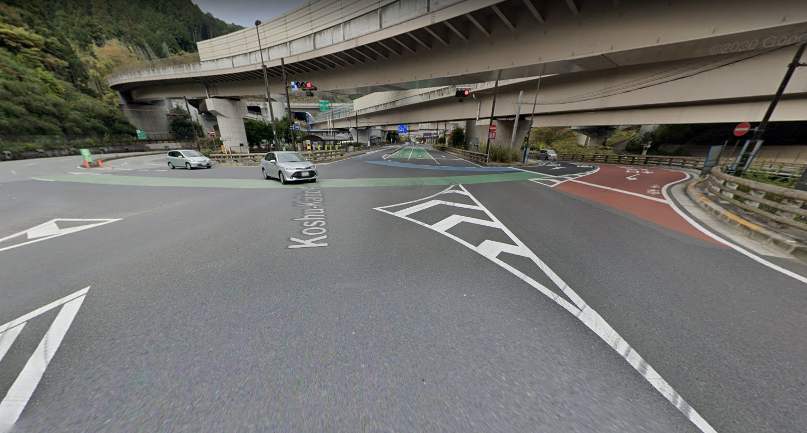
Takaosan Interchange, Hachioji, Japan
Notes:
But like this highway intersection. From this point of view you can see it is complex

Slide 4
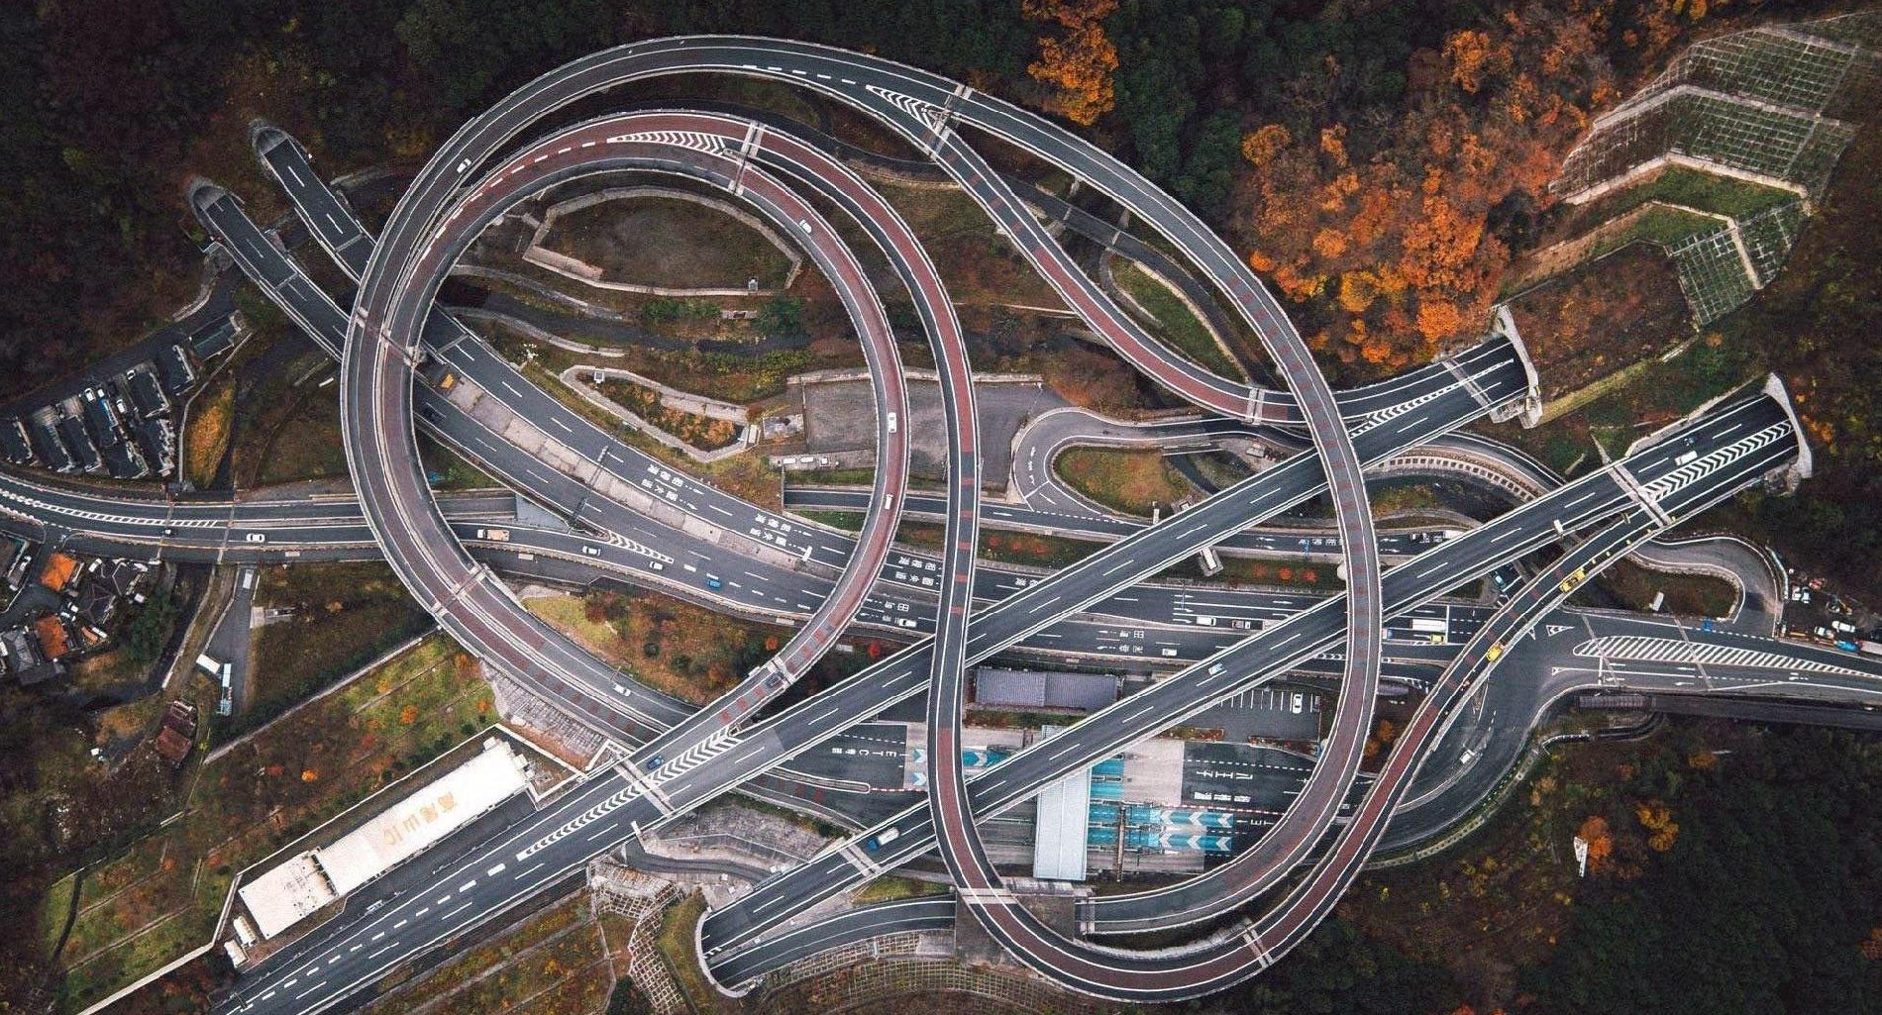
Notes:
But to really understand the structure you need a high level perspective

Slide 5
Problem
Difficult to get insight into the complexity of a code base

Slide 6

Fact
Reduce defects
Domain knowledge
Programing Languages
Impact Analyses
[Making Software Book, chapter 25, Where Do Most Software Flaws Come From?]
-
Notes:
From the book ‘Making Software’ chapter 25. Where Do Most Software Flaws Come From?. See https://www.oreilly.com/library/view/making-software/9780596808310/
The fastest way to product improvement as measured by reduced faults is to hire people who are knowledgeable about the domain of the product. Remember, lack of knowledge tended to dominate the underlying causes. The fastest way to increase the knowledge needed to reduce faults is to hire knowledgeable people.
One of the least important ways to improve software developments is to use a “better” programming language. We found relatively few problems that would have been solved by the use of better programming languages.
Techniques and tools that help to understand the system and the implications of change should be emphasized in improving a development environment. Remember that knowledge-intensive activities tended to dominate the means of prevention.

Slide 7

As developer

Slide 8
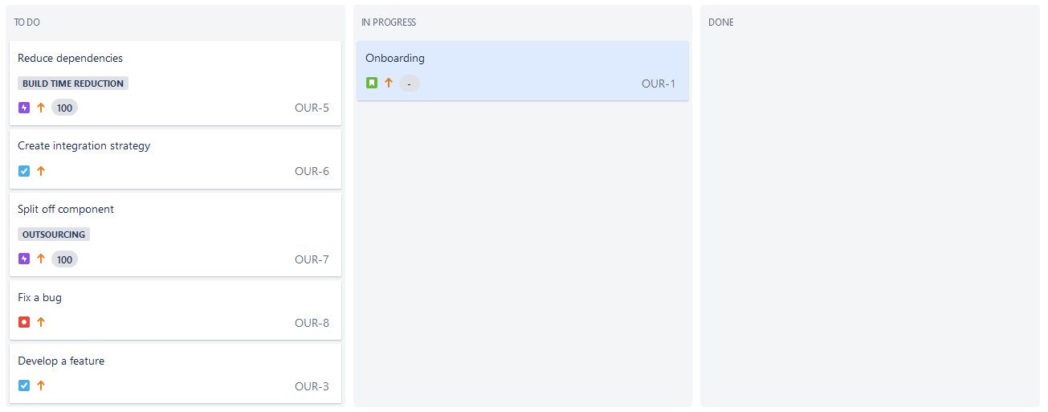
Notes:
You just started as a new developer on the team and want to get a high level view of the software you will be working on.
So you look got software architecture documentation, but there is none.

Slide 9
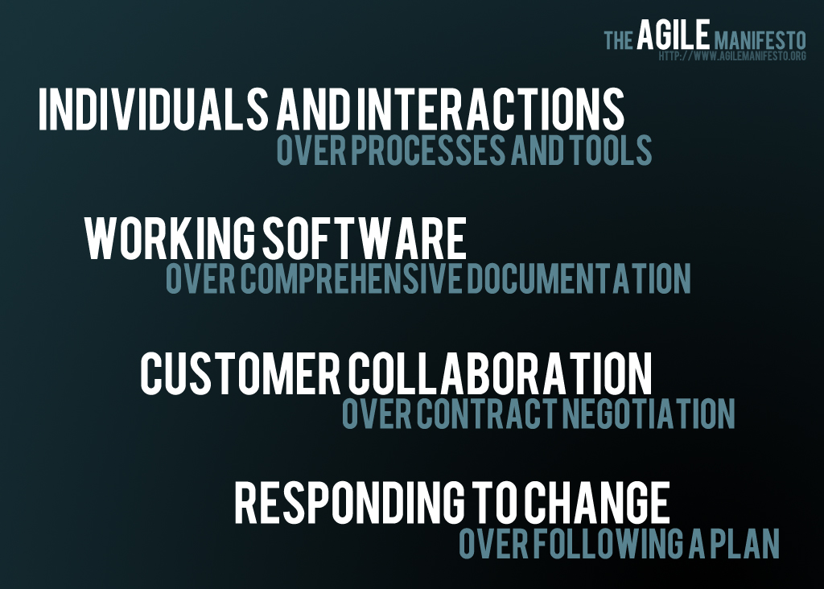
Notes:
It seems they misunderstood the agile manifesto. It says ‘over’ not ‘instead of’.
You do not need to document everything as in more formal software developments processes used a years ago, but you need to at least document the key concept, major design decsions and their rationale.
You can reverse engineer the source code, but never the rationale.

Slide 10
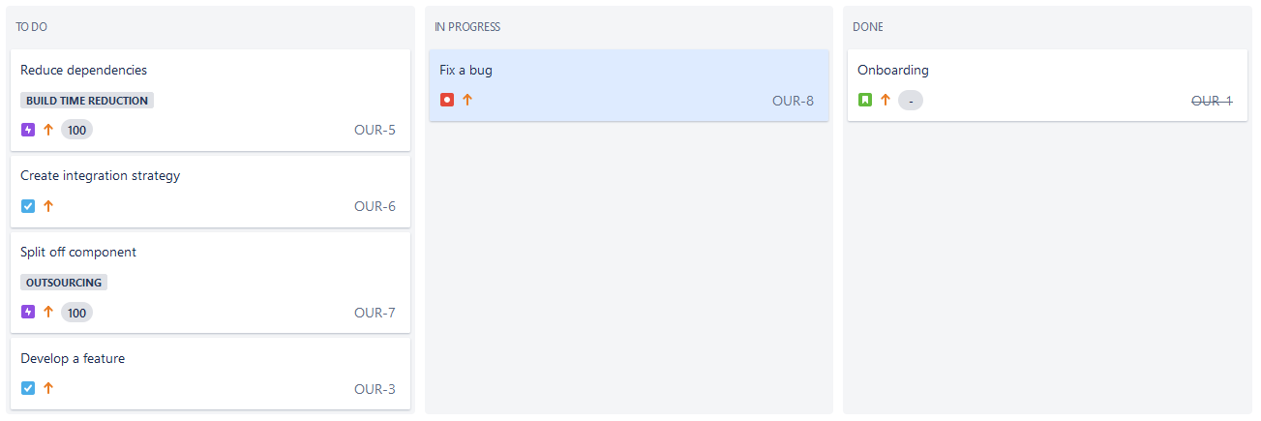
Notes:
After onboarding you start you first task to fix a defect, but notice it is very hard due to the complex software dependencies.

Slide 11

Fact
Modularization - The effort to locate a fault reduced by 50% for simple faults, and 20-25% for complex faults
[Accenture and Infosys study]
Notes:
Having a clean code structure helps fixing defects quicker.
See https://structure101.com/2012/08/02/surveys-show-that-software-structure-matters/

Slide 12
Notes:
You thought you solved the defect, but now its again back. What happened ?

Slide 13
Fact
Methods with higher cyclomatic complexity has a high bad fix probability
[Aivosto]
Cyclomatic complexity | Bad fix probability
1-10 | 5%
20-30 | 20%
>50 | 40%
approaching 100 | 60%
Notes:
https://www.aivosto.com/project/help/pm-complexity.html

Slide 14
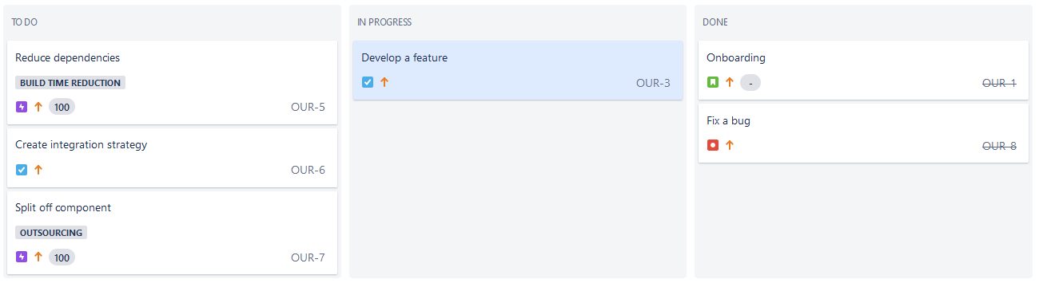
Notes:
After this you start implementing a new feature. You need extend the functionality of one source file. But you are not sure if a part of the functionality belongs there. It seems incohesive. So you start looking if there is a better place to implement this.
But you investigating takes quite some time again due to the complex structure of the code.

Slide 15

Fact
Developers spend up to 50 percent of their time searching for information
[Ko et al. 2007; Murphy et al. 2006]
Notes:
That is a significant amount of time. It would good if we could make this process more efficient. It takes a lot of time and the results are often disappointing.
In a study on software comprehension where you read.
Avoid comprehension
Another similar interesting aspect calling for further investigation is the avoidance of a deep understanding of the source code by observed developers. One potential reason is that software comprehension is a hard and time consuming task and consequently is avoided whenever possible.
Developers try to avoid comprehension whenever possible focusing rather on the expected output of the main development task such as extending a functionality or ﬁxing a bug.
Developers try to avoid comprehension by cloning pieces of code if they cannot comprehend all possible consequences of changes.
This behavior leads to technical debt.
It seems so wasteful.

Slide 16
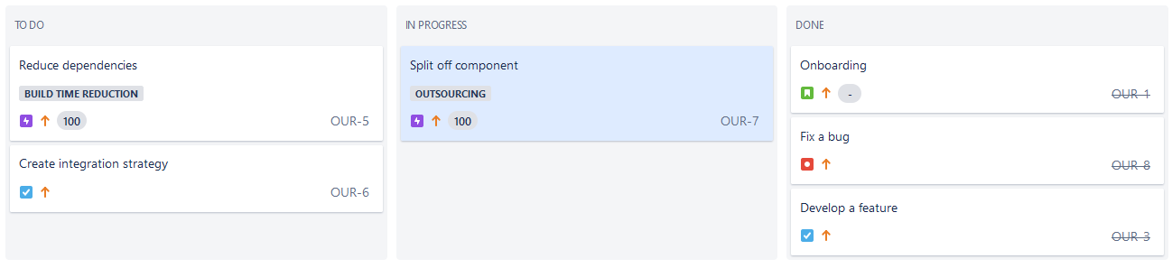
Notes:
Despite all difficulties you were able to successfully fix the defect and implement the feature.
You are now assigned a more complex task.
Management wants to outsource a part of the software your team develops, because you have insufficient resources.
You contact they software architect from some more background information.

Slide 17
A
B
C
D
E
F
G
Notes:
The current architecture consists of the following components.

Slide 18
A
B
C
D
To be outsourced
E
F
G
Notes:
The plan is to migrate components F and G to a separate source code archive. You think you understand the problem and make a commitment to the plan to outsource non business critical activities.

Slide 19
A
B
C
D
Required but overlooked by architect
E
F
G
Notes:
After you start implementing you discover thing are not that easy.
Because the software architect missed an important requirement and to resolve this a dependency from G to D was required. Your colleague added that to the implementation, but never gave feedback to the software architect, so her was not aware of this.

Slide 20
A
B
Quick fixes
D
Quick fixes
C
E
F
G
Notes:
As you dive deeper you find out things are even more difficult than anticipated.
Two other colleague also introduced some incorrect dependencies, while working under enormuous time pressure. They never fixed this.
It will be hard to isolate the two components and will likely not be able to meet the deadline.
Having an accurate image of the actual dependencies would have helped you to better estimate the work and risk involved.

Slide 21

Immobility
Notes:
The code for the components suffers from immobility. A term coined by Uncle Bob (Robert C. Martin).
It means the software can not be isolated, so not reused across projects.
It is caused by the software being tightly coupled to other parts.

Slide 22
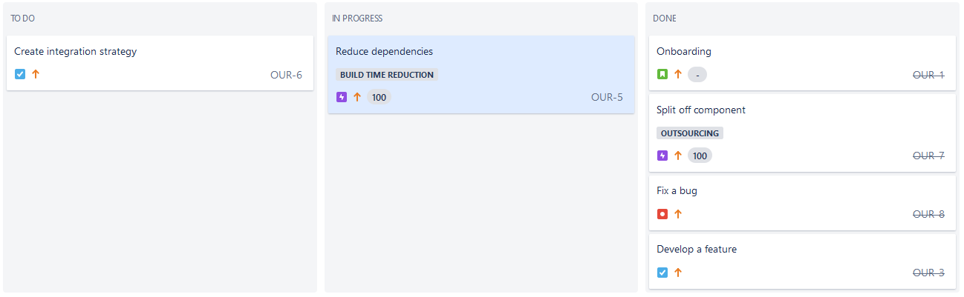
Notes:
After the refactoring task is put on hold, you are assigned a next task to reduce build time. A full rebuild takes about an hour.
The idea is to split the code base into a two smaller projects which can be build independently. You aim for a 50% reduction of the build time.
Sadly this is not possible to high coupling. You can only reduce 25%.

Slide 23


Slide 24
As tester

Slide 25
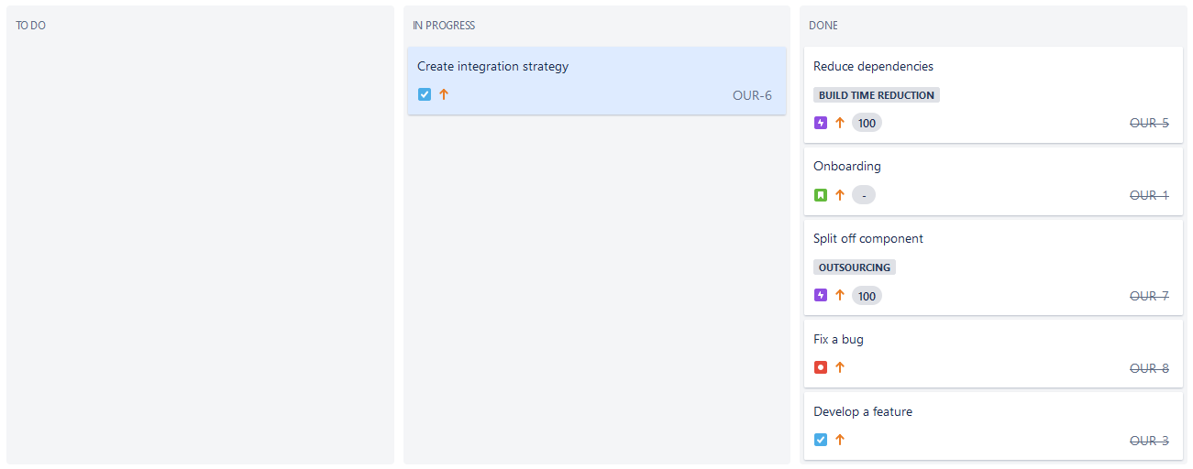
Notes:
You are assigned to create an integration strategy for the software.

Slide 26
A
5
B
5
1
4
C
D
E
3
1
2
F
G
Notes:
You come up with following integration order.
You discover that the split off of components was put on hold due to unexpected software dependencies.
That means your integration strategy will not work unfortunately.

Slide 27
A
?
B
?
?
?
C
D
E
?
?
?
F
G
Notes:
As you dive deeper you find out things are even more difficult than anticipated.
Two other colleague also introduced some incorrect dependencies, while working under enormuous time pressure. They never fixed this.
It will be hard to isolate the two components and will likely not be able to meet the deadline.
Having an accurate image of the actual dependencies would have helped you to better estimate the work and risk involved.

Slide 28



Where ?
Notes:
You need to find defect so developers can fix them.
It is impossible to test every thing, so you plan to do risk based testing. Therefor you would also would like to know which areas to focus your test effort on.

Slide 29
In-cycle components averaged 80% more bugs than the non-cycle components
[Using Hubs and Cyclicality to Relate Software Architecture and Quality, Tyson R. Browning et al, 2013]
Fact
Notes:
Areas with higher defect rate can be predict to some extend.

Slide 30
More defects - Increase up to 8.3X
[Cost of Complexity – Dan Sturtevant]
 | Very High | 5.86 | 8.39 | 13.66 | 18.42
 | High | 5.78 | 8.28 | 13.47 | 18.18
 | Mid | 4.49 | 6.44 | 10.47 | 14.13
 | Low | 2.22 | 3.18 | 5.18 | 6.98
 |  | Peripheral | Utility | Control | Core
McCabe
Classification
Fact
Architectural Classification
Notes:
https://dsmsuite.github.io/documents/sturtevant_050613.pdf

Slide 31
As architect

Slide 32
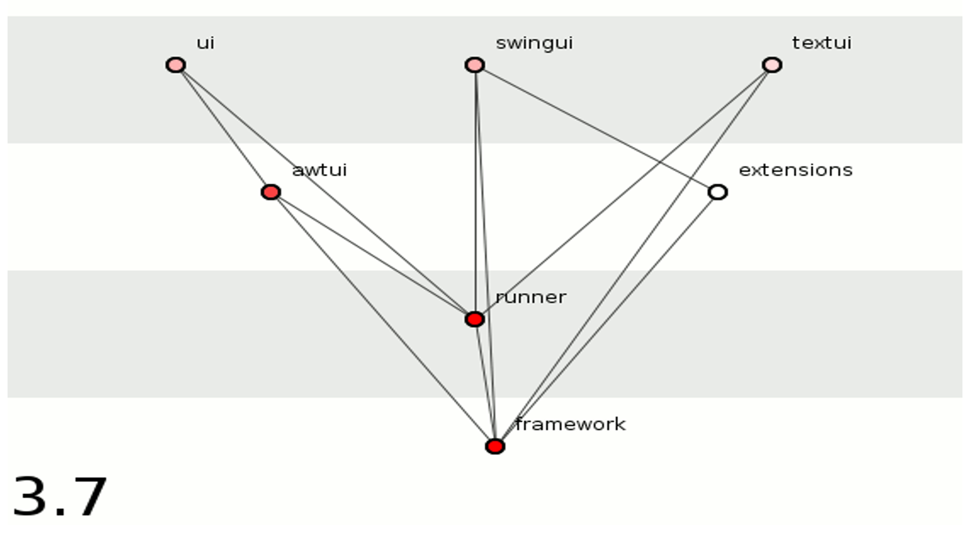


Slide 33
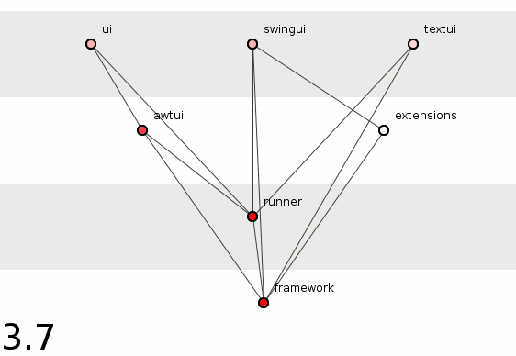

Slide 34
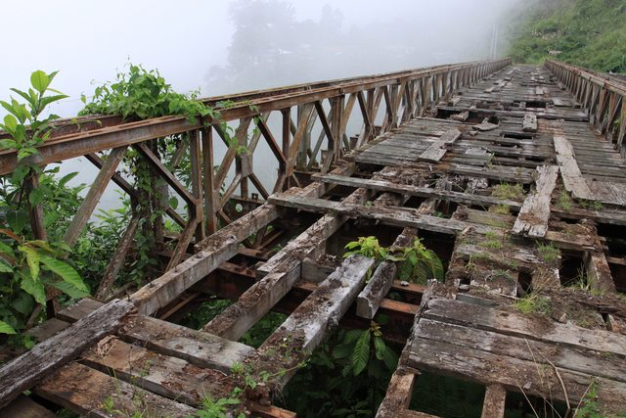
Your Software
Notes:
You are unhappy about what happened in the recent refactoring. It did not work out as expected due dependencies, which you were not aware of.
You realized this kind of deviation from the intended architecture happens all the time.
While youe software still fulfills its required purpose (you can use it to get to the other side, if you are lucky) its quality attributes are not at the required level anymore.

Slide 35

Rigidity
Notes:
It has becomes increasingly hard to add new features. They never seem to fit the current architecture.

Slide 36

Fragility
Notes:
You also notice that the software has become brittle. Now and then it breaks apart after having made a simple change.
All this is caused by poor management of he software dependencies.
You also notice it has become harder to make progress.

Slide 37

Lower productivity - 50% decline for complex code
[Cost of Complexity – Dan Sturtevant]
Fact
Notes:
https://dsmsuite.github.io/documents/sturtevant_050613.pdf
You could rewrite parts to improve the situation, but it would take to much time and involve too much risk.

Slide 38

Refactoring
Notes:
You decide that architecture level refactoring is required to improve the situation.
In road reconstruction they change and reroute the roads while traffic can continue.
Your refactoring should be like that. It is what some call ensuring product continuity.

Slide 39
Fact
In large software projects drastic changes should not be made without considering continuity from the former architecture.
[Architecture Migration using DSM in a Large Scale Software Project, Takashi Maki, 2012]
Notes:
In large software projects, we believe that drastic changes should not be made without considering continuity from the former architecture.
From this viewpoint, we planned architecture migration using
the source code of products from the former architecture to the new architecture.
The new architecture
is determined by referring to the former architecture in consideration of product continuity.
You understand you a kind of feedback loop in your architecture process.
There is a mismatch between the intended architecture and the actual implementation. Sometimes developers fix things you missed but sometimes they do not provide feedback. In other cases developers go against the intended architecture because they are not aware or are under time pressure.

Slide 40

Intentional architecture
Defines a set of purposeful, planned architectural strategies and initiatives, which enhance solution design, performance, and usability and provide guidance for inter-team design and implementation synchronization.
Emergent design
Provides the technical basis for a fully evolutionary and incremental implementation approach. This helps developers and designers respond to immediate user needs, allowing the design to evolve as the system is built and deployed.
Notes:
You have heard about the scaled agile framework where the have something called intentional architecture and emergent design.

Slide 41




Intentional
Architecture
Define
Guidance
Adjust
Software
Architect
Fix Source Code
Software
Developers
Develop
Feedback
Abstract
Emergent
Design
Source
Code
Notes:
You question how the source code can give you feedback. It is impossible to inpsect all source files.
You need some way to abstract from the source code details, so can get the high level perspective.
Code visualization can help.

Slide 42
As manager

Slide 43


Slide 44

Fact
Higher staff turnover - 10x increase in voluntary and involuntary terminations for complex code
[Cost of Complexity – Dan Sturtevant]
Notes:
You recently noticed some people leaving the company.
https://dsmsuite.github.io/documents/sturtevant_050613.pdf

Slide 45
Impact
Cost of unmanaged code complexity can be huge

Slide 46
Visualization Techniques
Notes:
So if code visualization can help, what kind of visualizations are helpful. Let is discuss some.
The most common notation is with lines and boxes.

Slide 47
Fact
Industry developers do not use program comprehension tools such as visualization, concept location or software metric tools.
[On the Comprehension of Program Comprehension, Walid Maaley et al 2014]
Notes:
Source visualization can help here, but these kind of tools are not often used by developers

Slide 48
Lines and Boxes
Notes:
So if code visualization can help, what kind of visualizations are helpful. Let is discuss some.
The most common notation is with lines and boxes.

Slide 49

Notes:
UML is best known lines and boxes notation

Slide 50
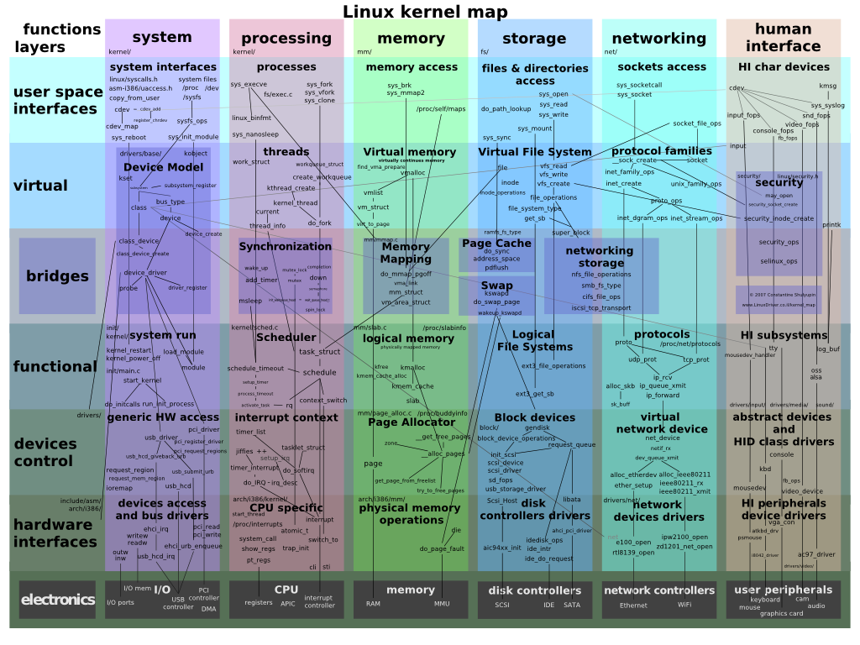
Notes:
But at some point it becomes too cluttered

Slide 51
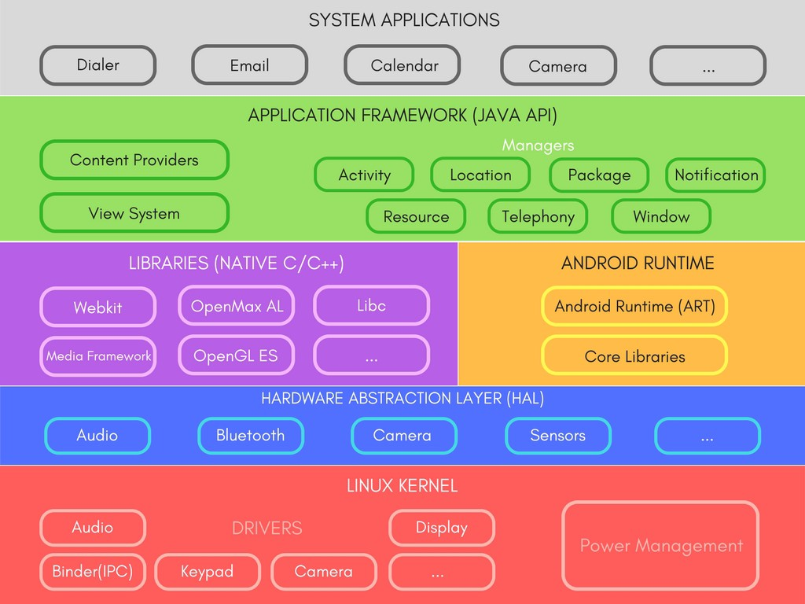
Just Boxes No Lines
Notes:
And then only boxes are shown.

Slide 52
“The highest-level breakdown of a system into its parts; the decisions that are hard to change”
[Patterns of Enterprise Application Architecture, Martin Fowler]
“.... software elements, the externally visible properties of those elements, and the relationships among them”
[Software Architecture in Practice (2nd edition), Bass, Clements, and Kazman]
Notes:
But if you at some software architecture definition essential elements are missing in that case and with this notation only some level of layering is suggested and the relations and not explicitly defined anymore.

Slide 53
Design Structure Matrix

Slide 54
Many dependencies
Wrong direction
UML
Skip layer
Cycle
Not used

Slide 55
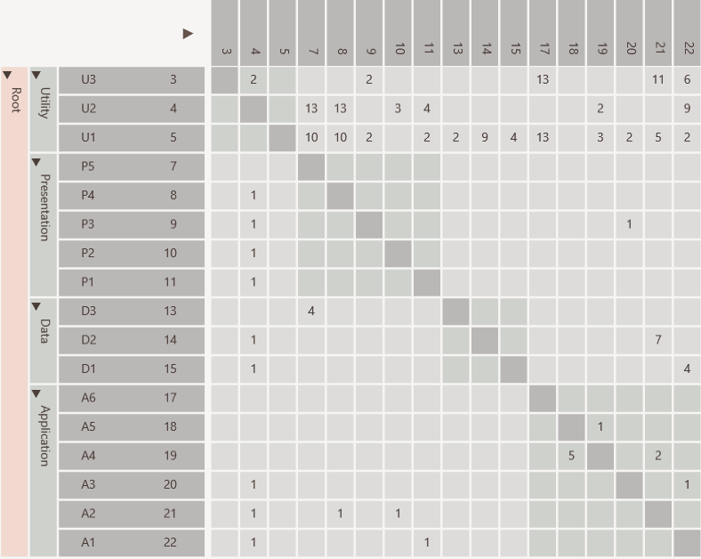
Same rows and columns
Definition
Identity line
P5 uses D3
Value indicates strength
Hierarchy

Slide 56
Dependencies from A1 to U1, U2 and U3
individually
Scalable

Slide 57
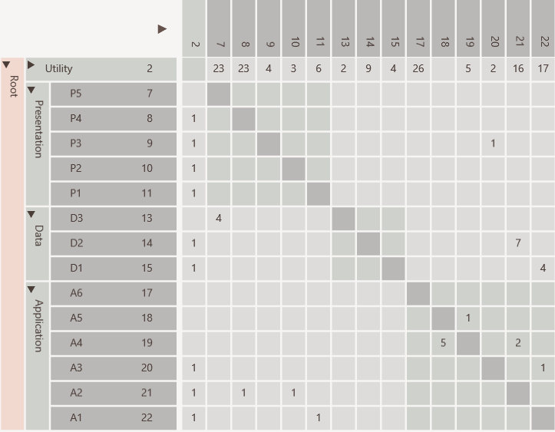
Dependencies from A1 to U1, U2 and U3
aggregated
Scalable

Slide 58
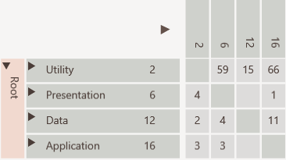
Scalable
All dependencies between Application and Utility collapsed

Slide 59
Many dependencies above identity line
Discovery

Slide 60
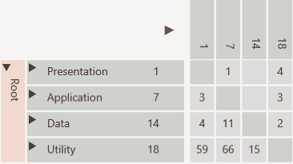
Consumers to top
Cycle easily visible
Discovery
Providers to bottom

Slide 61
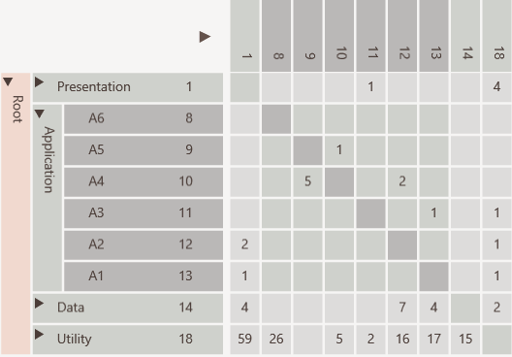
Not used
Discovery
Cycle
Public interface
Encapsulated

Slide 62
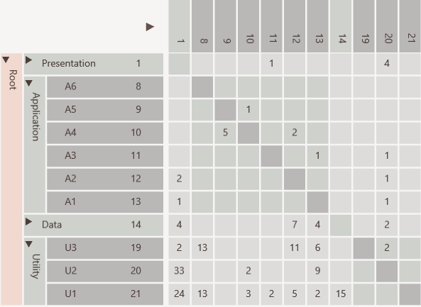
Discovery
Elements used in entire software like utilities and data access objects

Slide 63
Discovery
U2 is a change propagator because has many in and out going dependencies

Slide 64
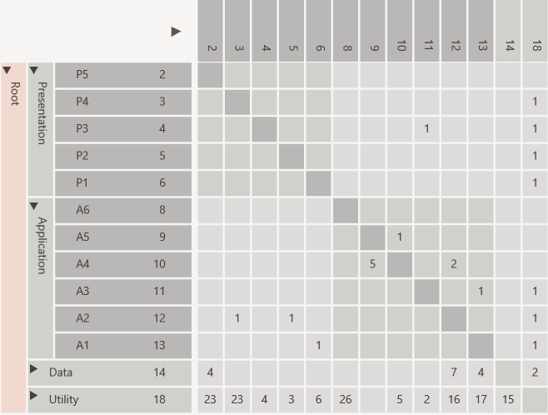
Hierarchical cycle due to
A3 using P3
which violates layering
Refactoring

Slide 65
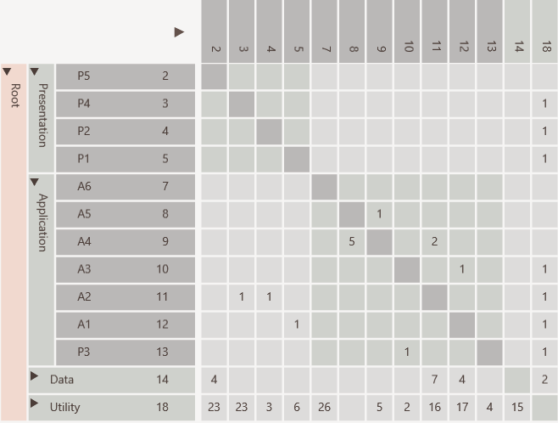
Cycle removed
Refactoring
Moved P3

Slide 66
Software Architecture
DSM can bridge gap
Key concepts
Communication
Low level details
Source Code

Slide 67

Goal is open source DSM tool supporting multiple programing languages
Notes:
To provide a free open source tool suite for DSM visualization supporting at least dependency visualization and impact analysis.
To support a number of well known programming languages and environments.
To allow for easy extension to support other programming languages and environments.
To allow integration into a continuous integration build chain.

Slide 68




Slide 69
Comparer
Analyzer
Compares
Analyzer
Analyzer
Analyzer
DSI
file
Viewer
DSM
file
Analyzer
Exports
Imports
Visualizes
.Net, Java, C++, Visual Studio and UML
Conforms To
dsi.xsd
Third Party Analyzer

Slide 70
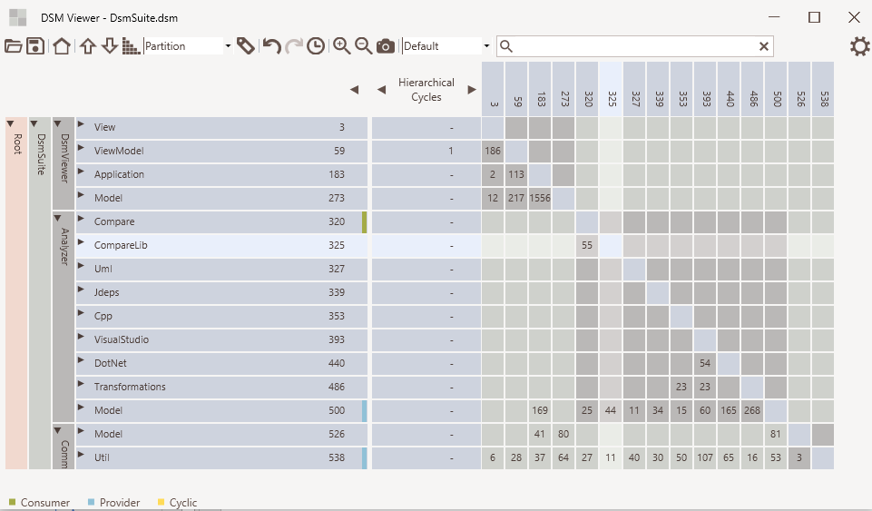

Slide 71





Road Ahead
Support standard graph formats Dot, GraphML and Gexf
Analyze C/C++ using build info from make files
Linux support
Support more and better portioning algorithms
Consider integration with source trail
yed
sourcetrail

Slide 72
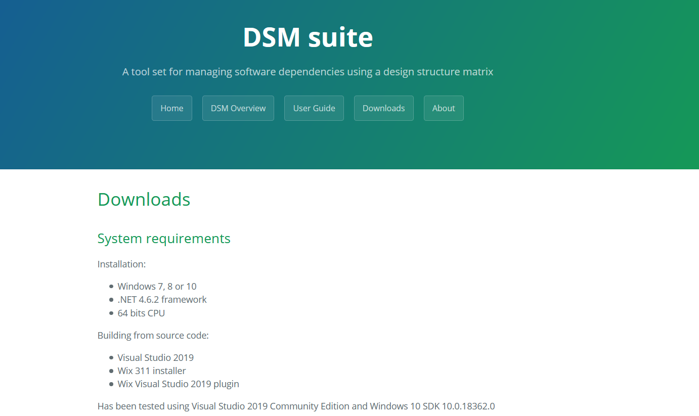
https://dsmsuite.github.io/

Slide 73
Treemap Metrics Visualization

Slide 74
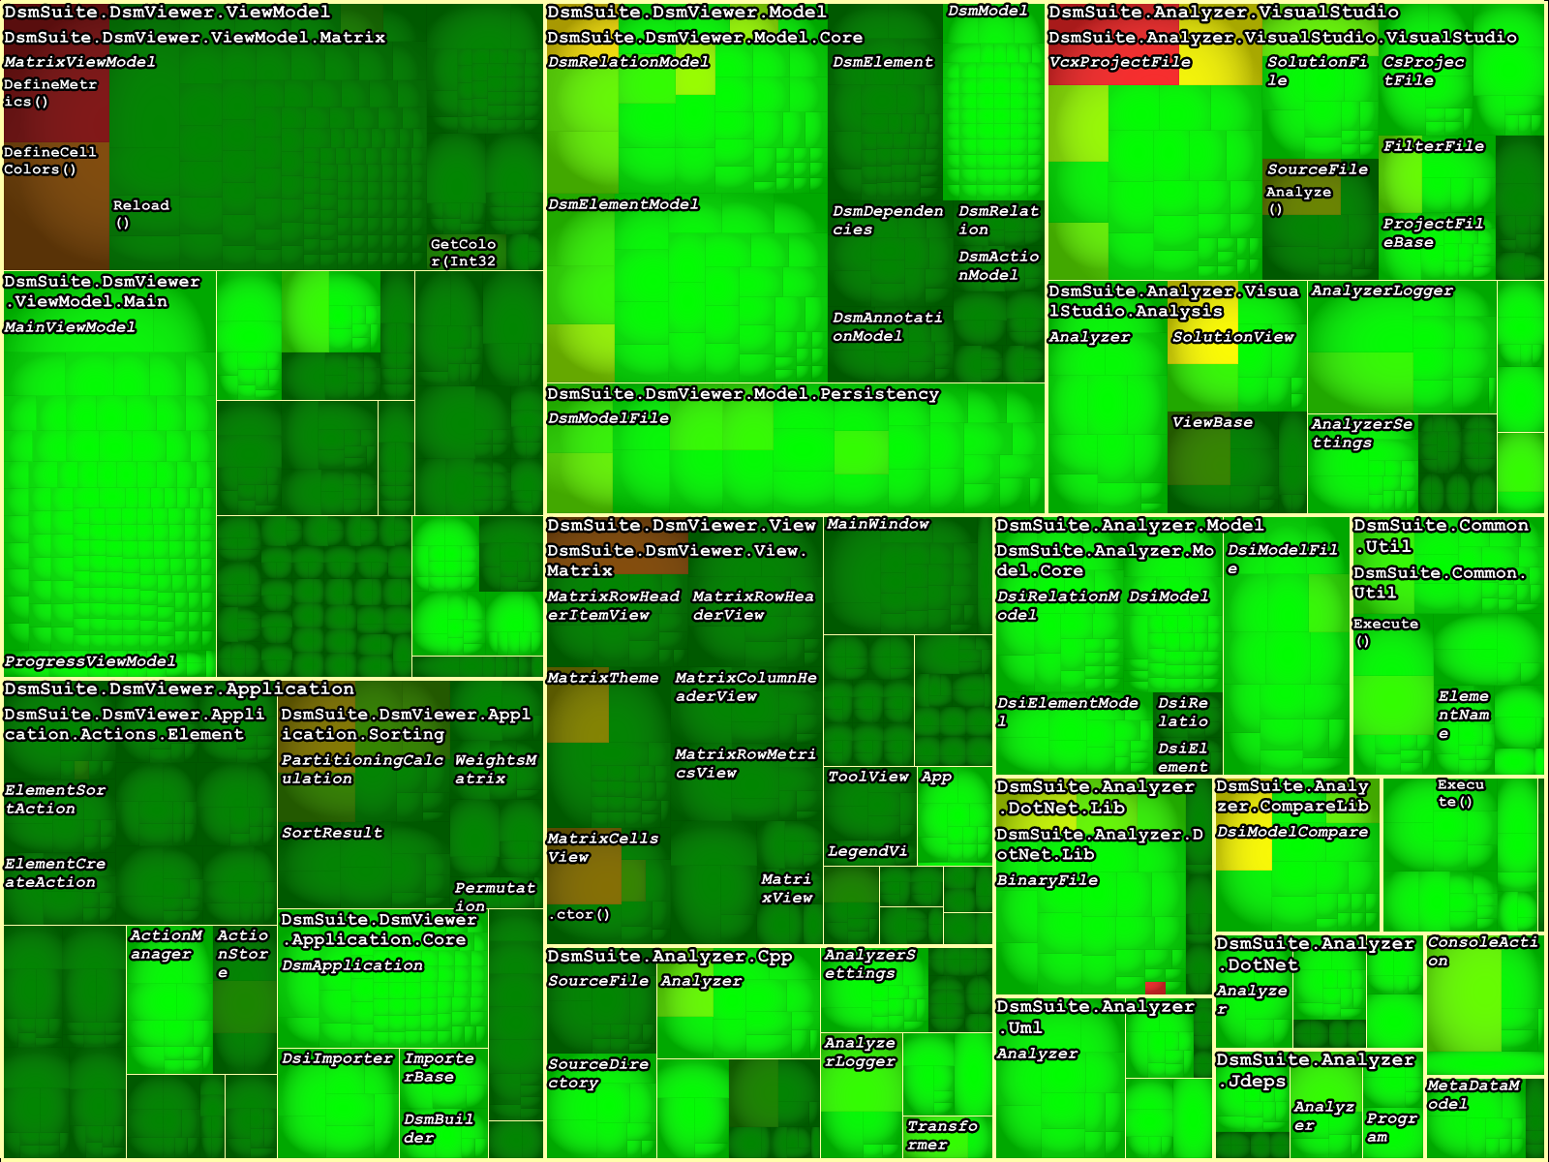

Slide 75
Code City Metrics Visualization

Slide 76
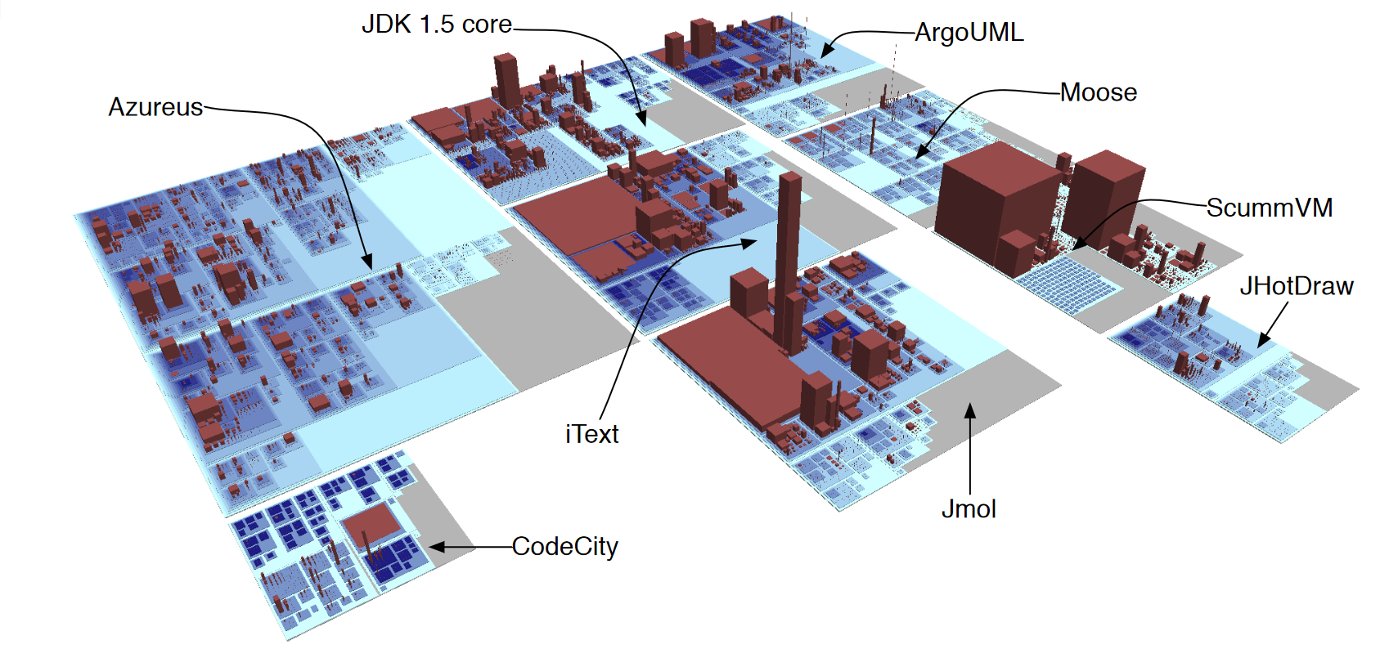
Notes:
Links
https://softvis3d.com/
https://www.axivion.com/en/blog/codecity/
http://wettel.github.io/

Slide 77
Solution
Visualization helps to get insight into code complexity

Slide 78
Tools

Slide 79
Programming
Language
Checks
Design
Metrics
Dependency
Visualization

Slide 80


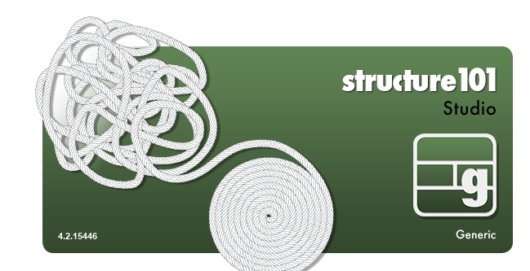


Slide 81
DsmSuite

Slide 82
Comparer
Analyzer
Compares
Analyzer
Analyzer
Analyzer
DSI
file
Viewer
DSM
file
Analyzer
Exports
Imports
Visualizes
What to expect
.Net, Java, C++, Visual Studio and UML
Conforms To
dsi.xsd
Third Party Analyzer

Slide 83
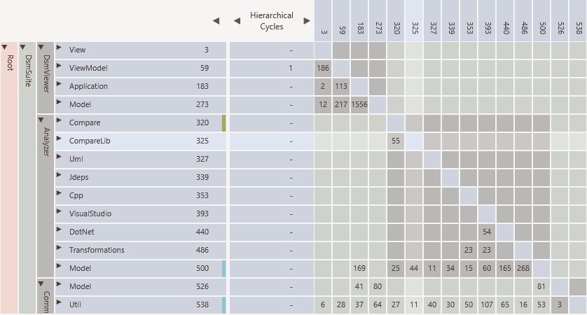

Slide 84
DEMO

Slide 86
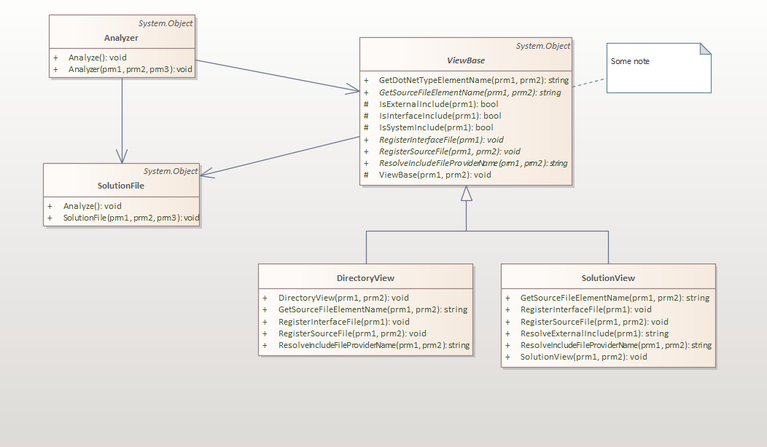

Slide 87
DEMO

Slide 89
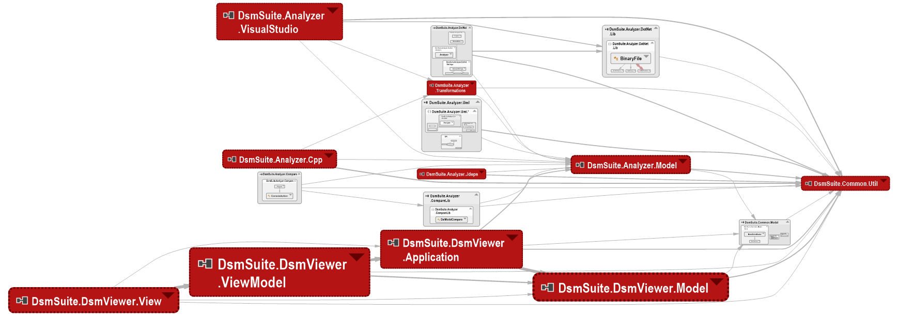

Slide 90
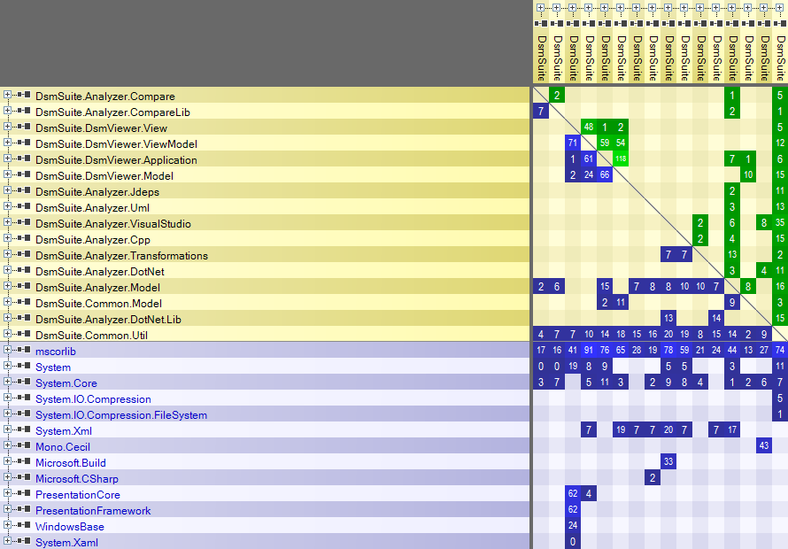

Slide 92
DEMO

Slide 93
ArgoUml

Slide 94
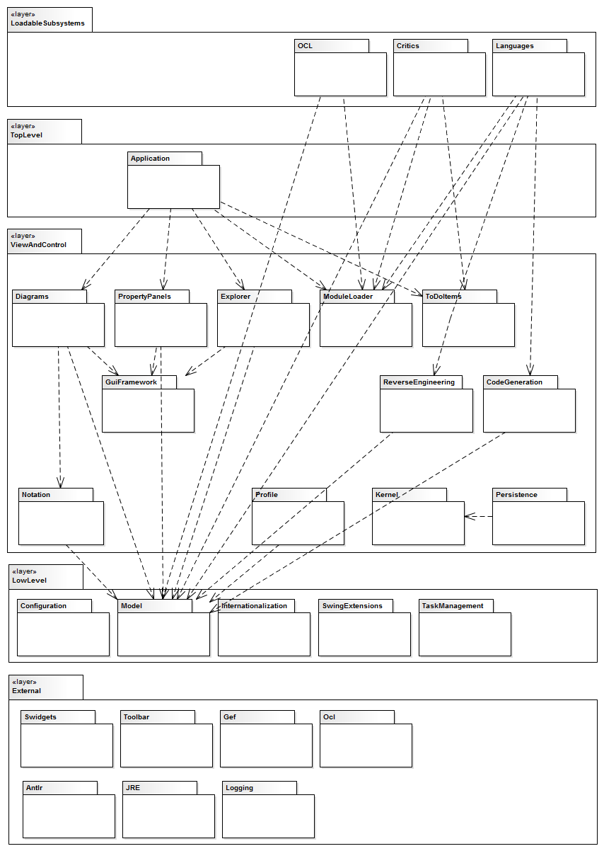
What to expect
Notes:
https://dsmsuite.github.io/argouml/

Slide 95
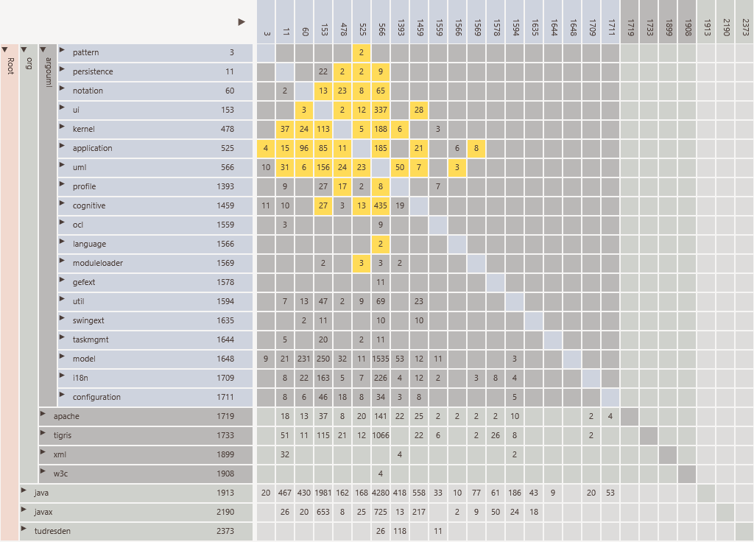

Slide 97
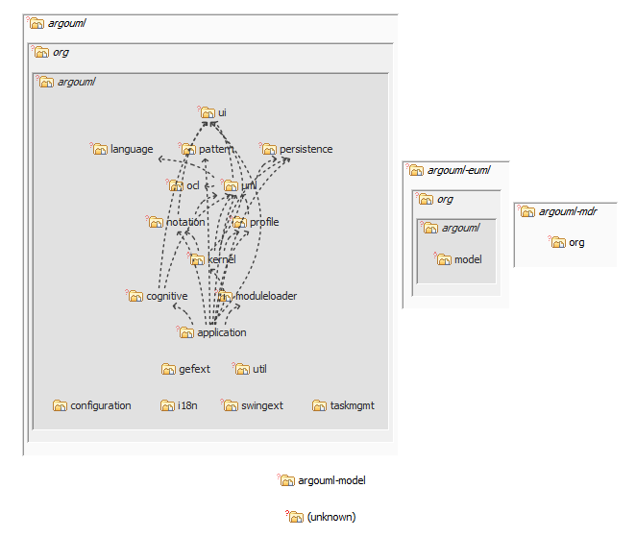
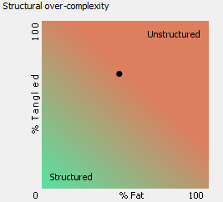

Slide 98
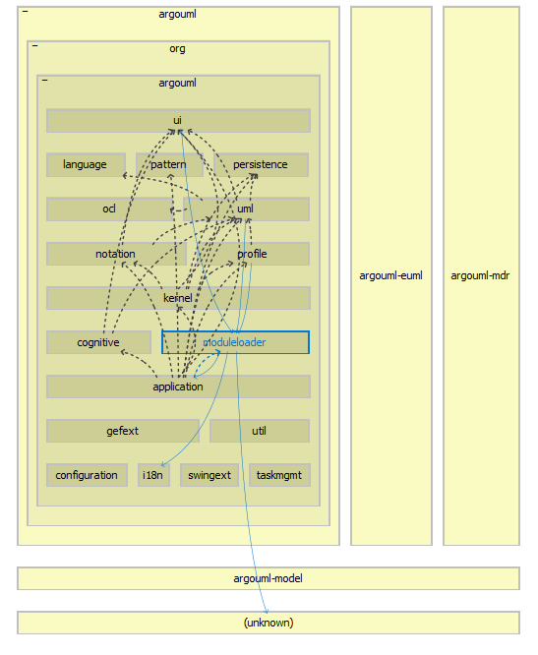

Slide 99
DEMO

Slide 100
Telegram

Slide 101
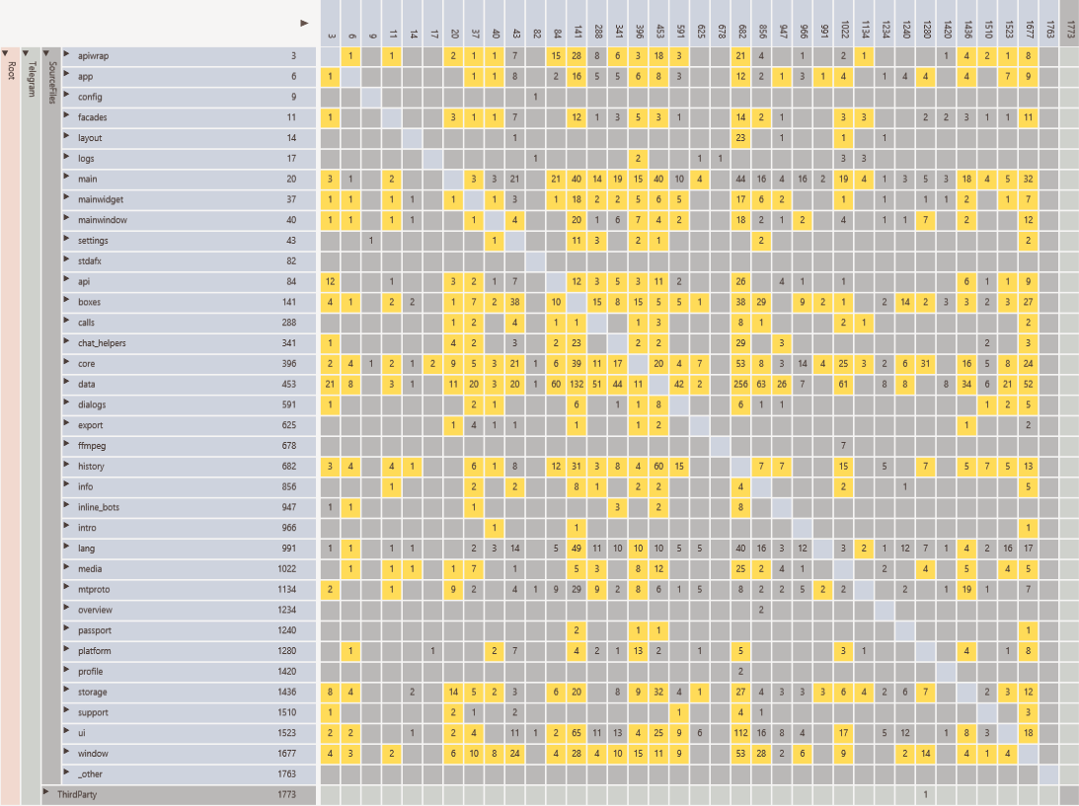

Slide 102
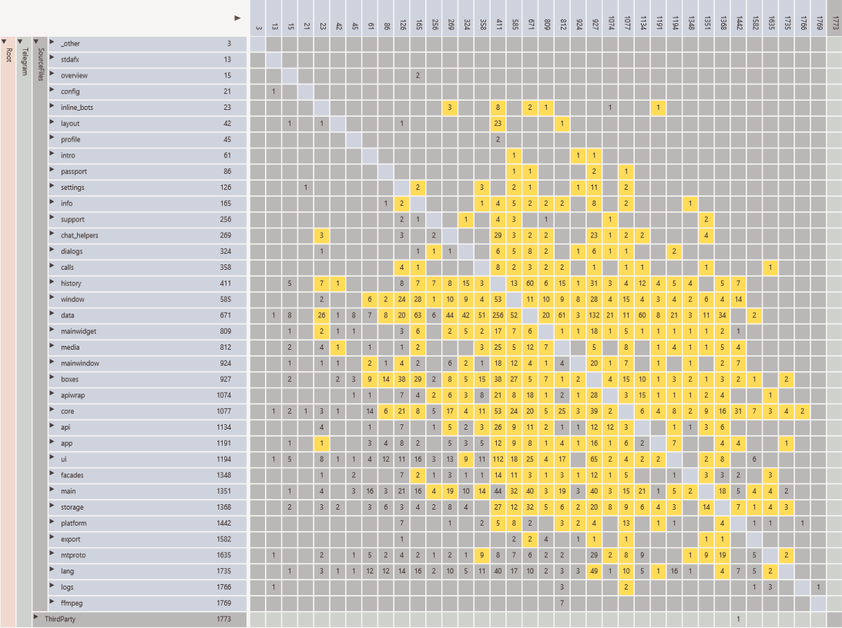
Defect here

Slide 103
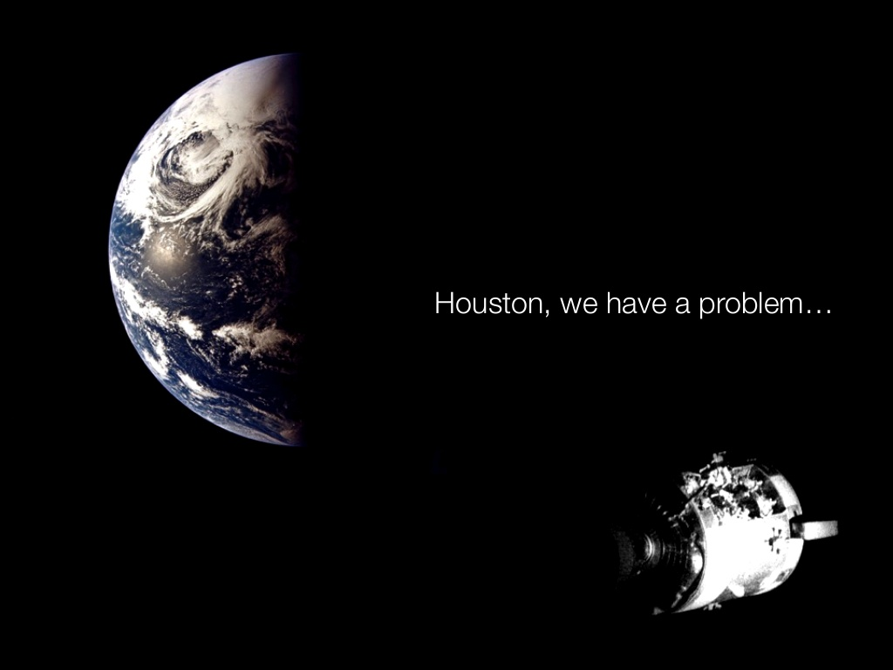

Slide 104
Poco

Slide 105
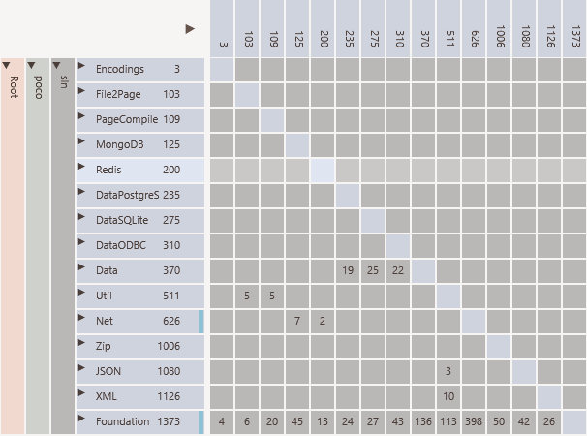
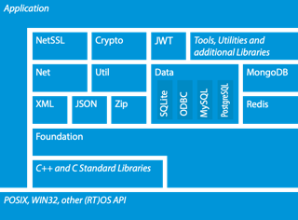
Not
in DSM
Not in diagram
MySQL missing
Not suggested by diagram
Suggested by diagram

Slide 106
Qt

Slide 107
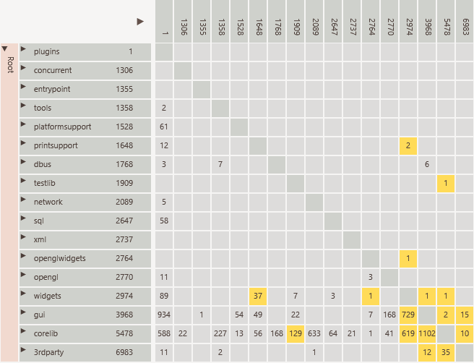
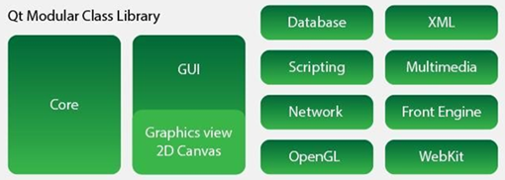
Not in diagram
Network, database, xml
GUI
Third party depends on QT

Slide 108
Linux Kernel

Slide 109
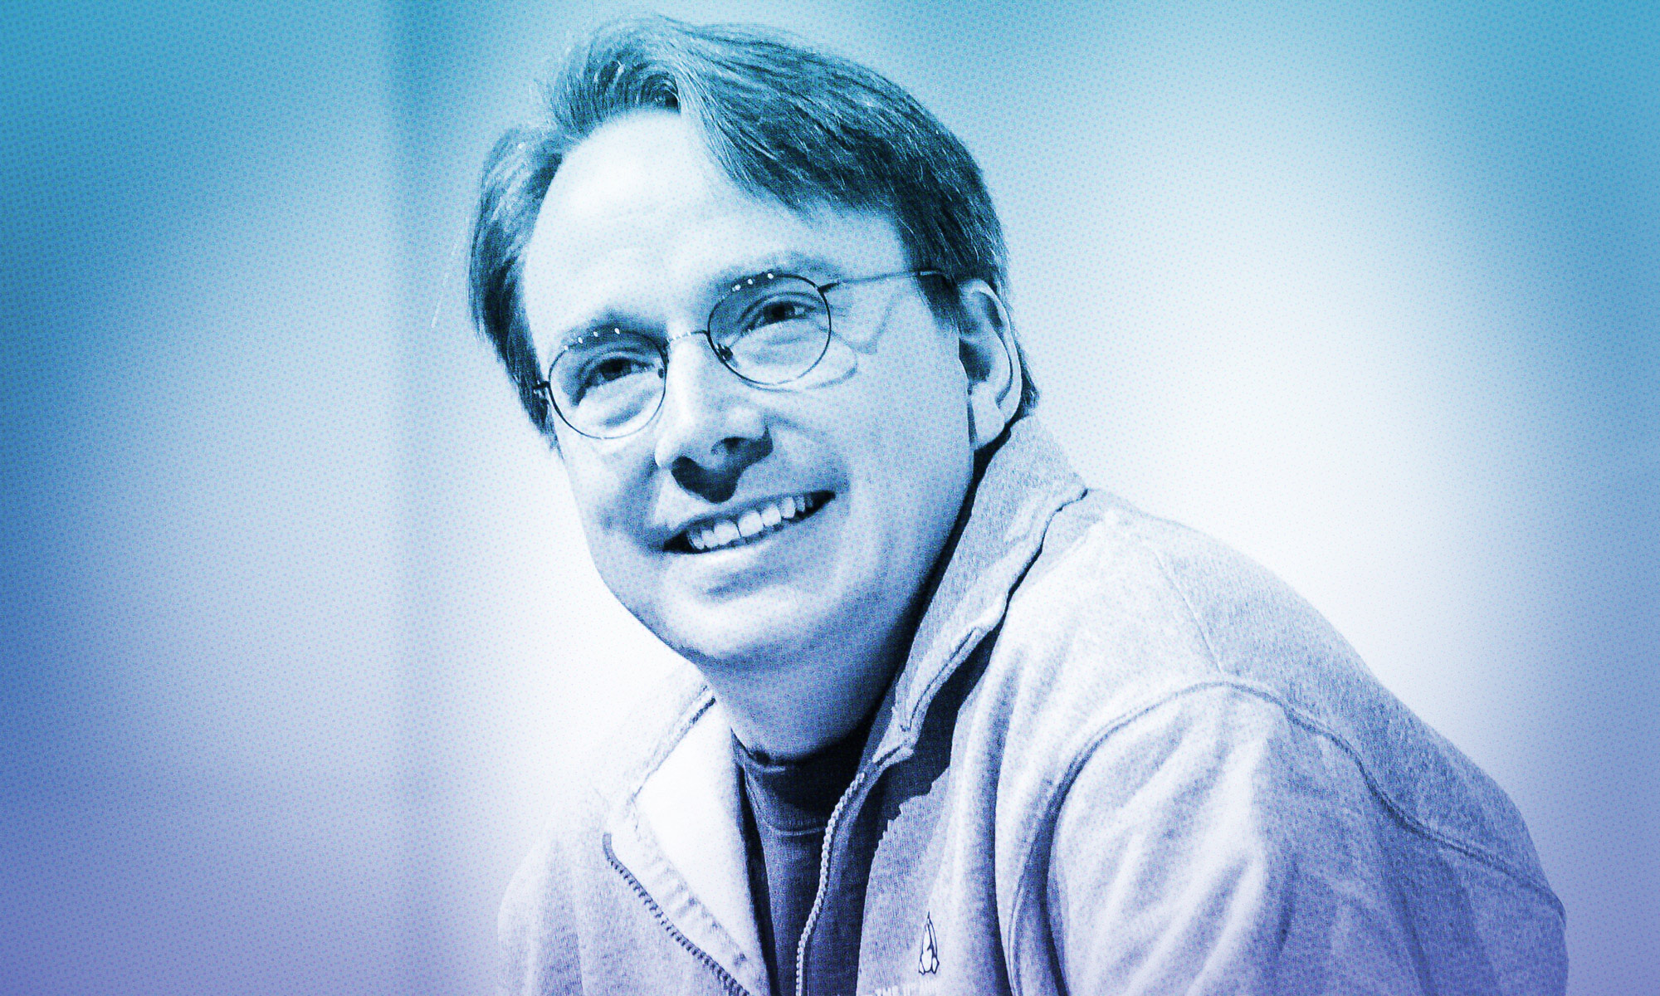
Linus Torvalds on where Rust will fit into Linux
Torvalds thinks "Rust's primary first target seems to be drivers, simply because that's where you find just a lot of different possible targets, and you have these individual parts of the kernel that are fairly small and independent.
Kroah-Hartman agrees that "drivers are probably the first place for an attempt like this as they are the 'end leafs' of the tree of dependencies in the kernel source. They depend on core kernel functionality, but nothing depends on them."
What to expect
Notes:
https://www.zdnet.com/article/linus-torvalds-on-where-rust-will-fit-into-linux/

Slide 110
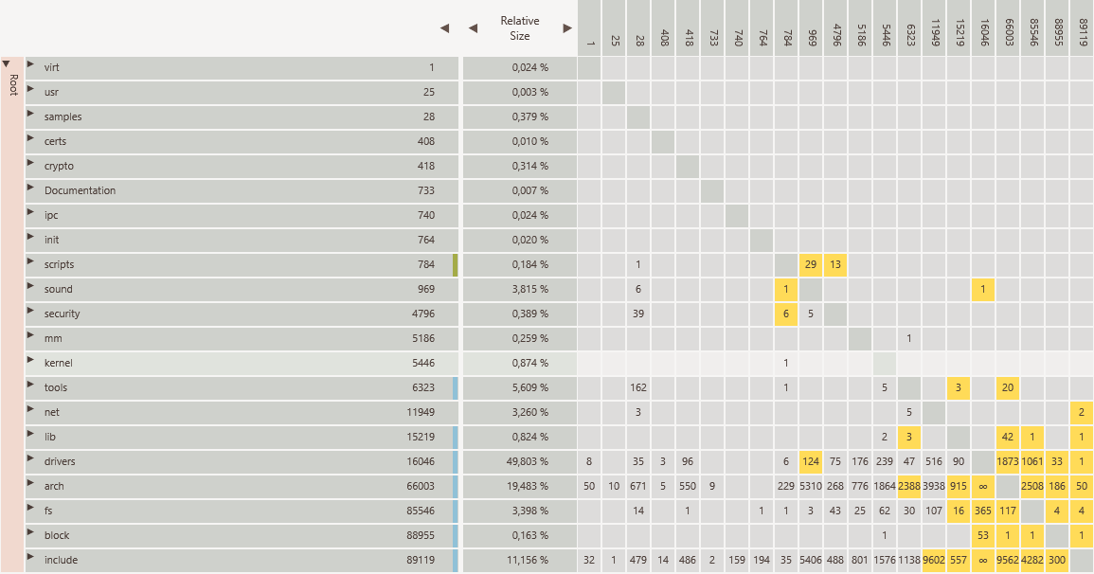

Slide 111
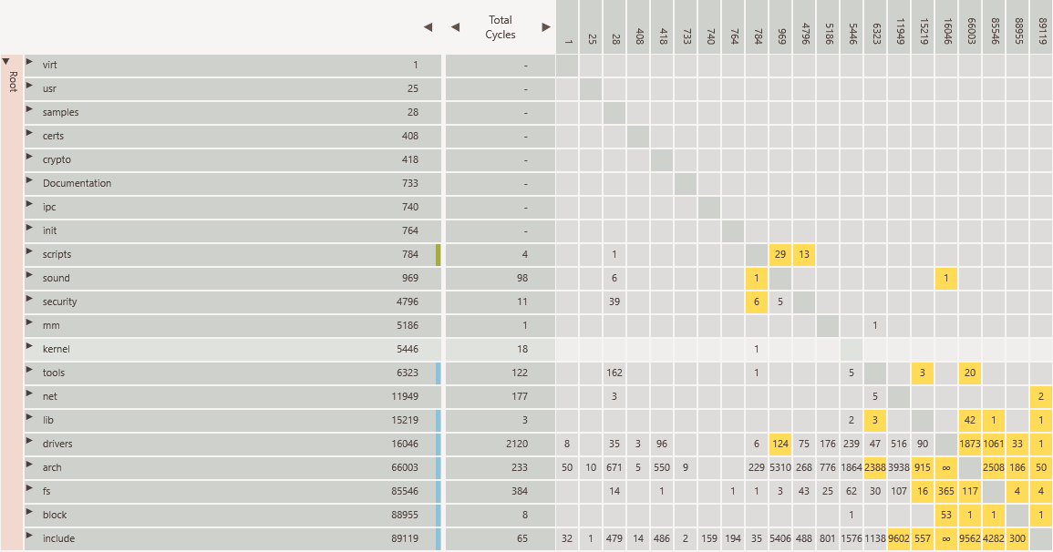

Slide 112
DEMO

Slide 114
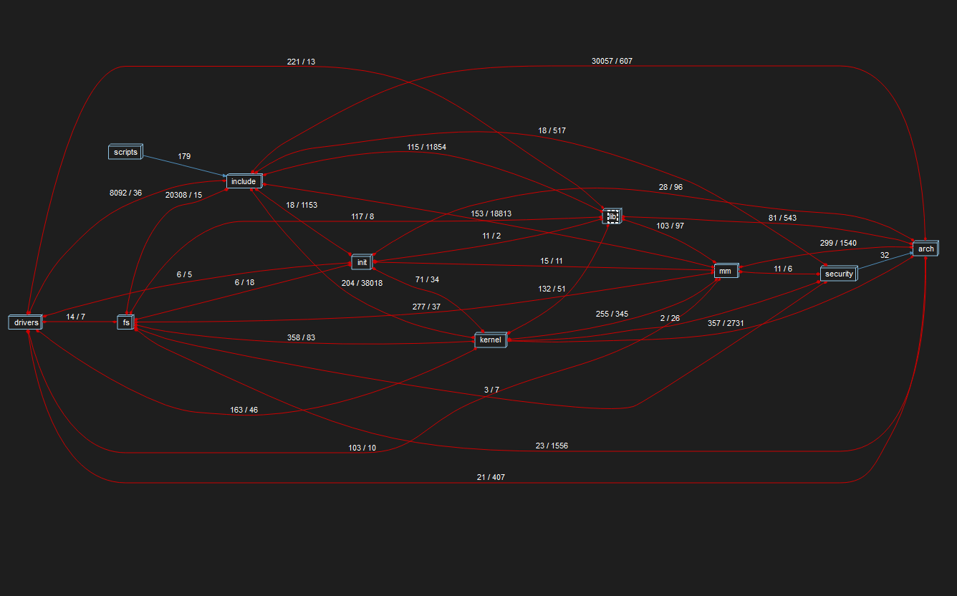

Slide 115
DEMO

Slide 116
Analysis Spring Framework
Notes:
https://www.infoq.com/presentations/code-organization-large-projects/

Slide 117
The Spring development team manages software dependencies currently using Structure101
What to expect

Slide 118
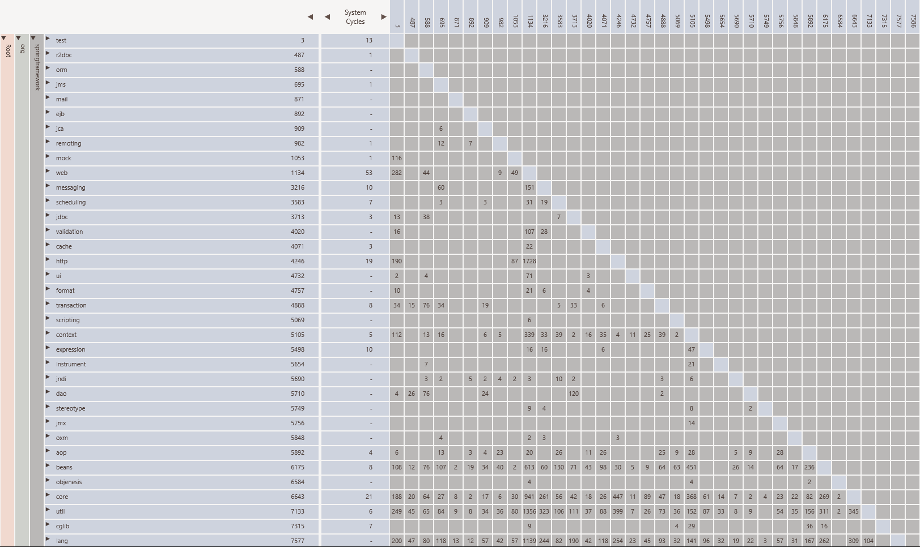

Slide 120
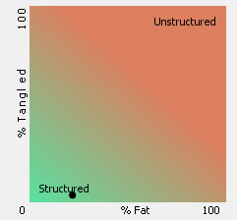
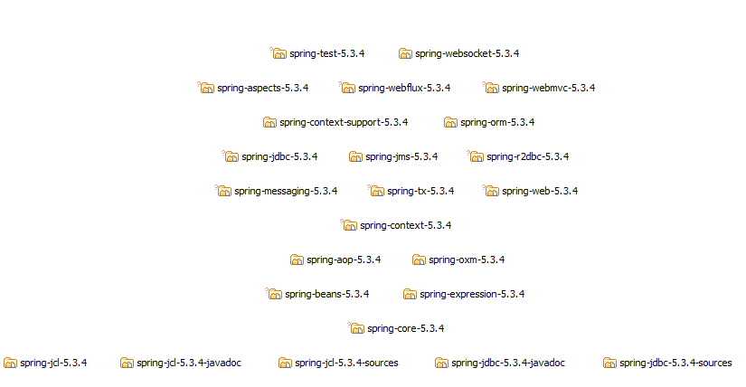

Slide 121
DEMO

Slide 122
Tools
Both commercial and open source tools are available. Best choice depends on user situation.

Slide 123
So ….

Slide 124
Code complexity often not visible
Can be very expensive
Active management is required
Visualization can help

Slide 125

Best time to start ?

Slide 126

Notes:
Try it
Was it useful
Provide feedback

Slide 127

Clean code

Slide 128

Notes:
See https://javascript.plainenglish.io/30-funny-code-comments-that-will-make-you-laugh-1c1b54d4ab00
Based on a question what is a good code comment. Funny.
It actual is a very code comment for very bade code.
Based on Dante. Text written on gates of hell. No happy onboarding here.
From Dante - La Divina Commedia
https://nl.wikibooks.org/wiki/Gedichten_uit_de_wereldliteratuur/Lasciate_ogni_speranza,_voi_ch%27entrate

Slide 129

Any Questions
Notes:
Does this matter

Slide 130


